Slide 1
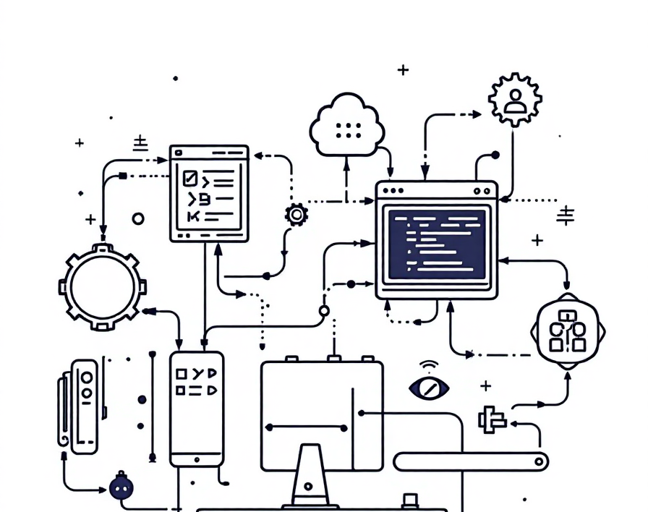
Securing the Software Supply Chain

Slide 2
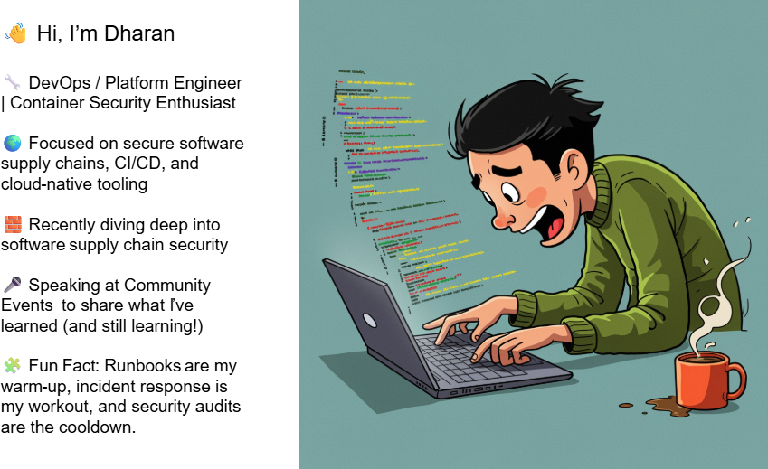

Slide 3
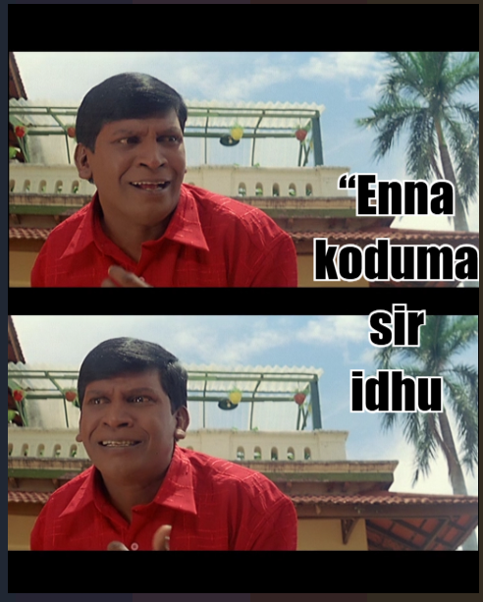
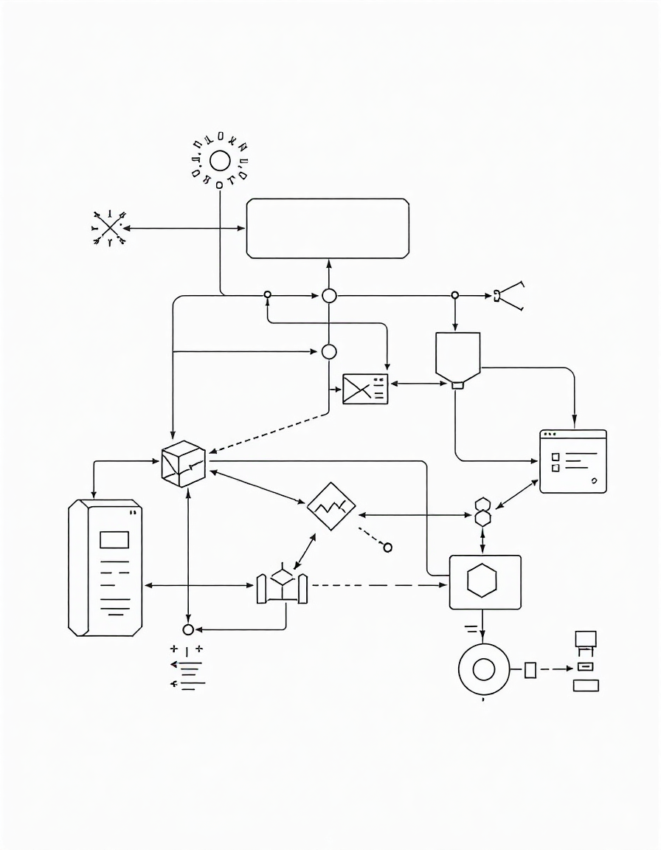


Software Supply Chain Security

Slide 4
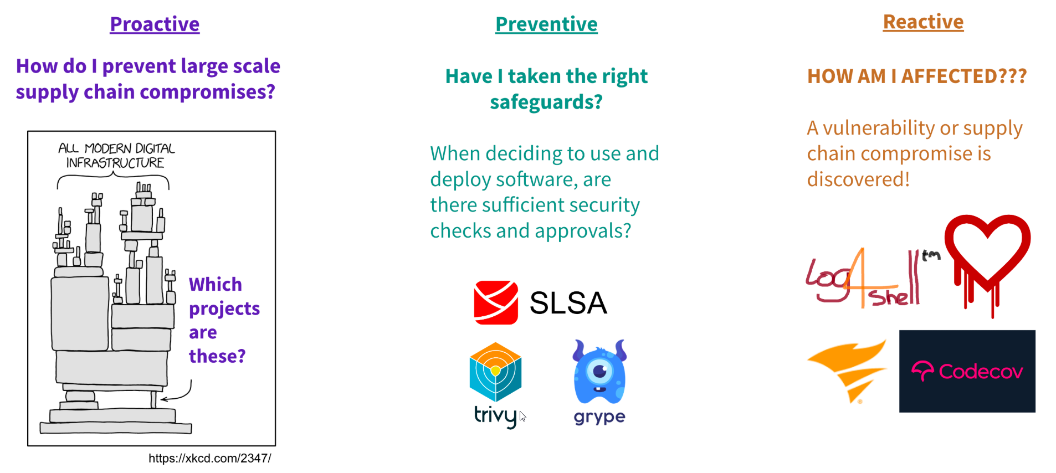
Software Supply Chain Security

Slide 5
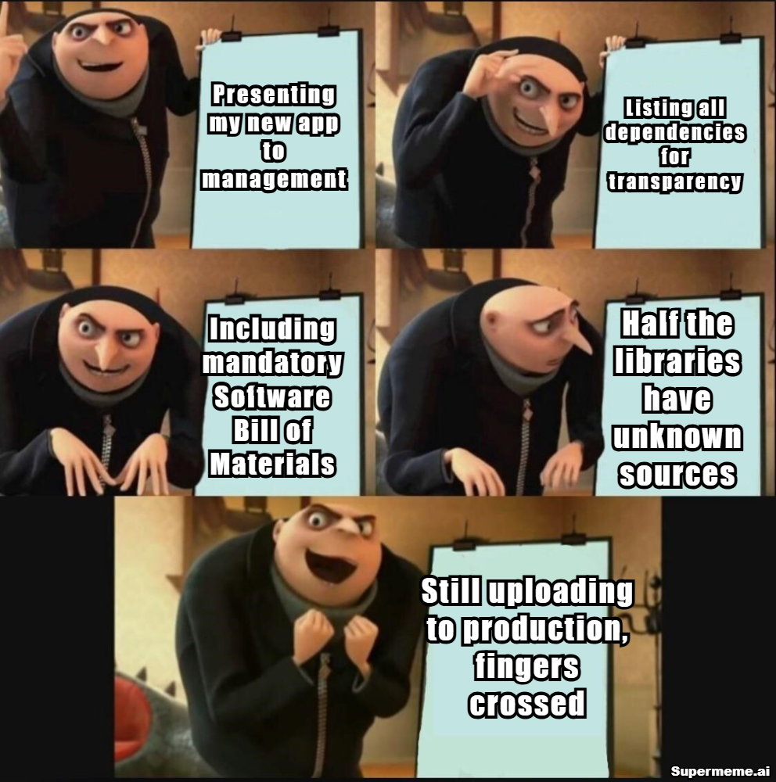
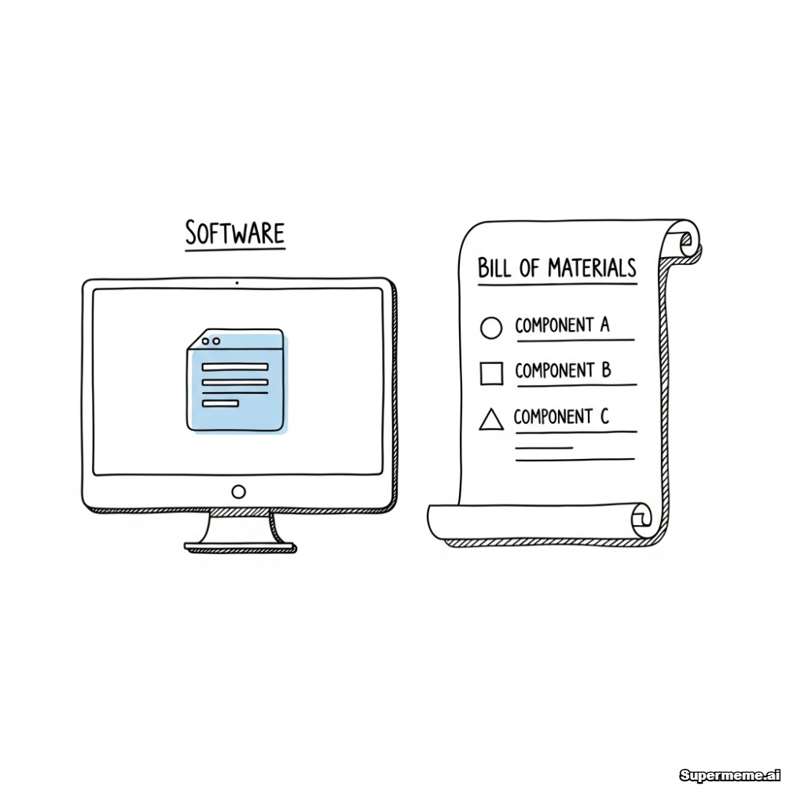
SBOM

Slide 6
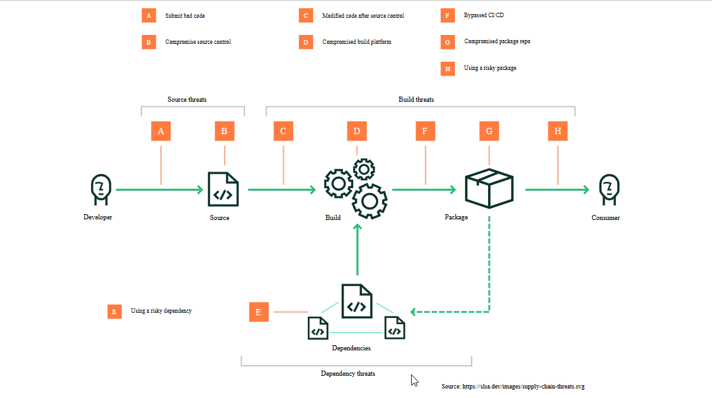
Critical Attack Vectors

Slide 7
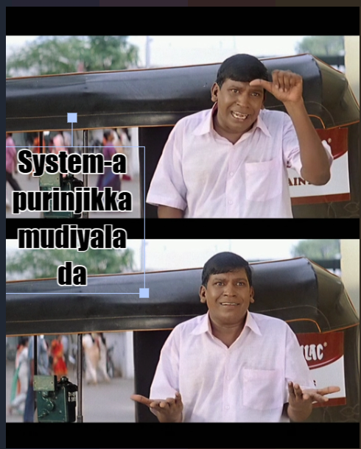

What is SLSA ?
SLSA = Supply-chain Levels for Software Artifacts → A framework by Google to ensure the integrity and trust of software artifacts. → Think of it like a “security ladder” for your build and release process.

Slide 8




SLSA Framework Levels
Level 1: Build is Scripted but Unverified
Build process is documented and provenance is generated, establishing basic transparency into how software is built.
Level 2: Build is Scripted & Authenticated
Provenance is authenticated and the build service generates signed metadata, preventing post-build tampering.
Level 3: Build is Hermetic & Reproducible
Source and build platforms meet specific security standards with hardened infrastructure and non-falsifiable provenance.
Level 4: Complete End-to-End Security
Two-person review of all changes and hermetic, reproducible builds provide maximum protection against determined adversaries.

Slide 9
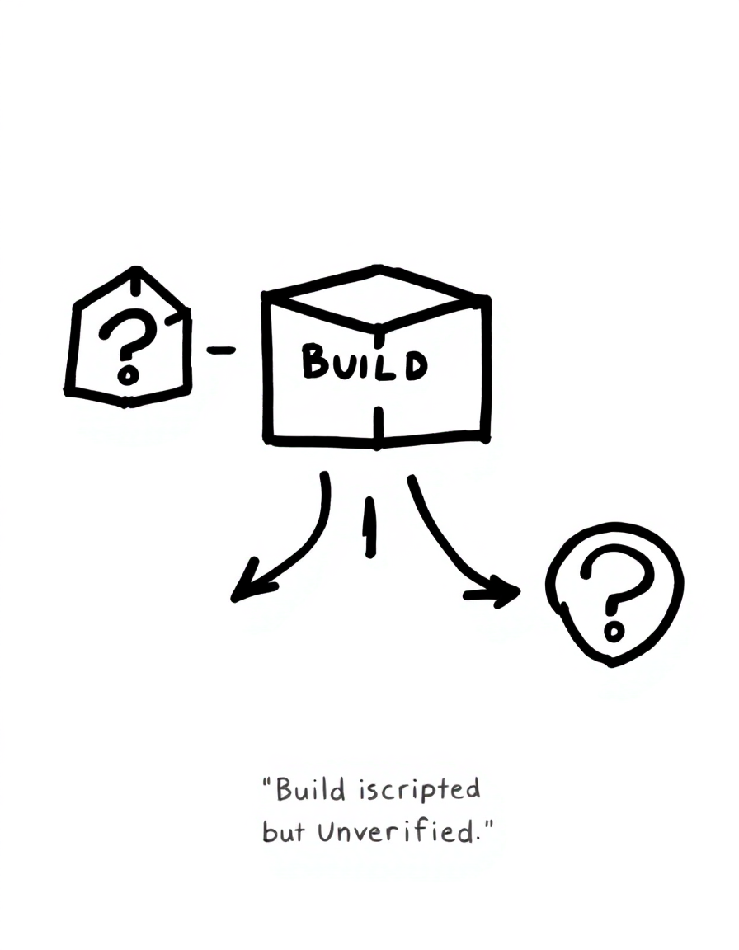

SLSA Level 1 — “Build is Scripted but Unverified”
Source and build process are documented.
But no guarantee the build output matches the source.
🧠 Punchline: “This is like trusting your friend to
send production code through WhatsApp zip file.”

Slide 10
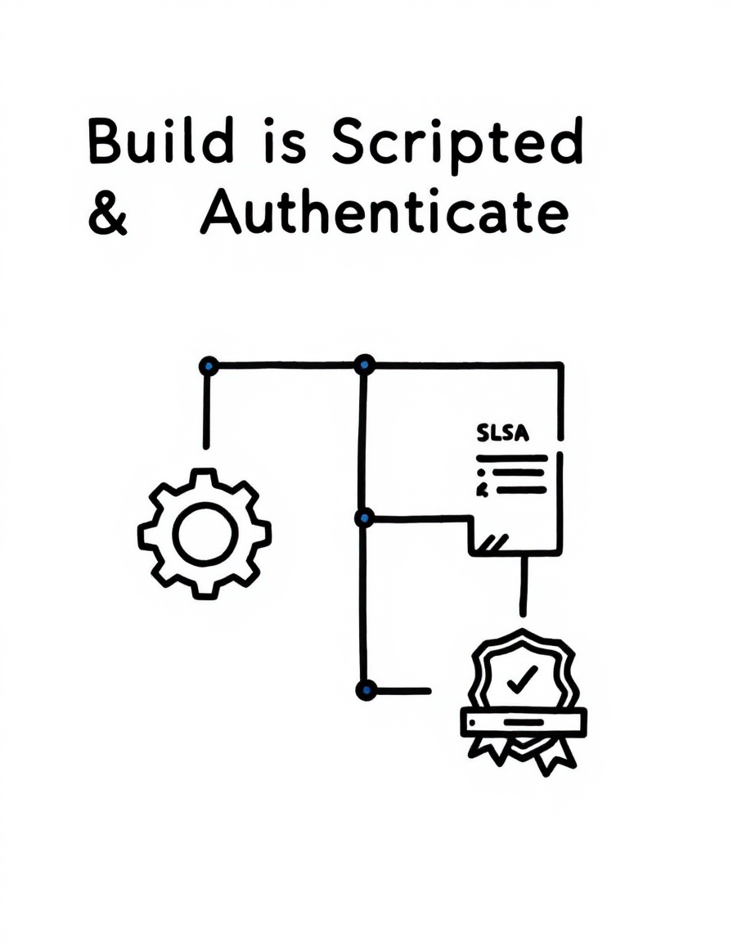
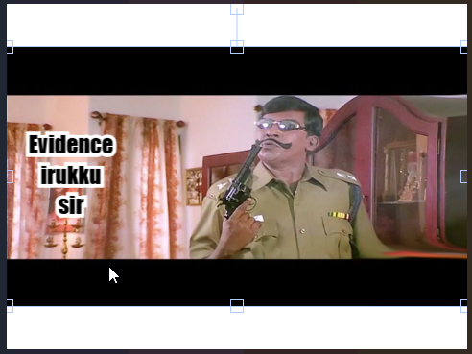
SLSA Level 2 — “Build is Scripted & Authenticated”
Build service generates provenance.
Artifacts are signed — so you can prove who built what
Punchline: “At least now, we can catch the intern who deployed to prod on Friday evening.”

Slide 11
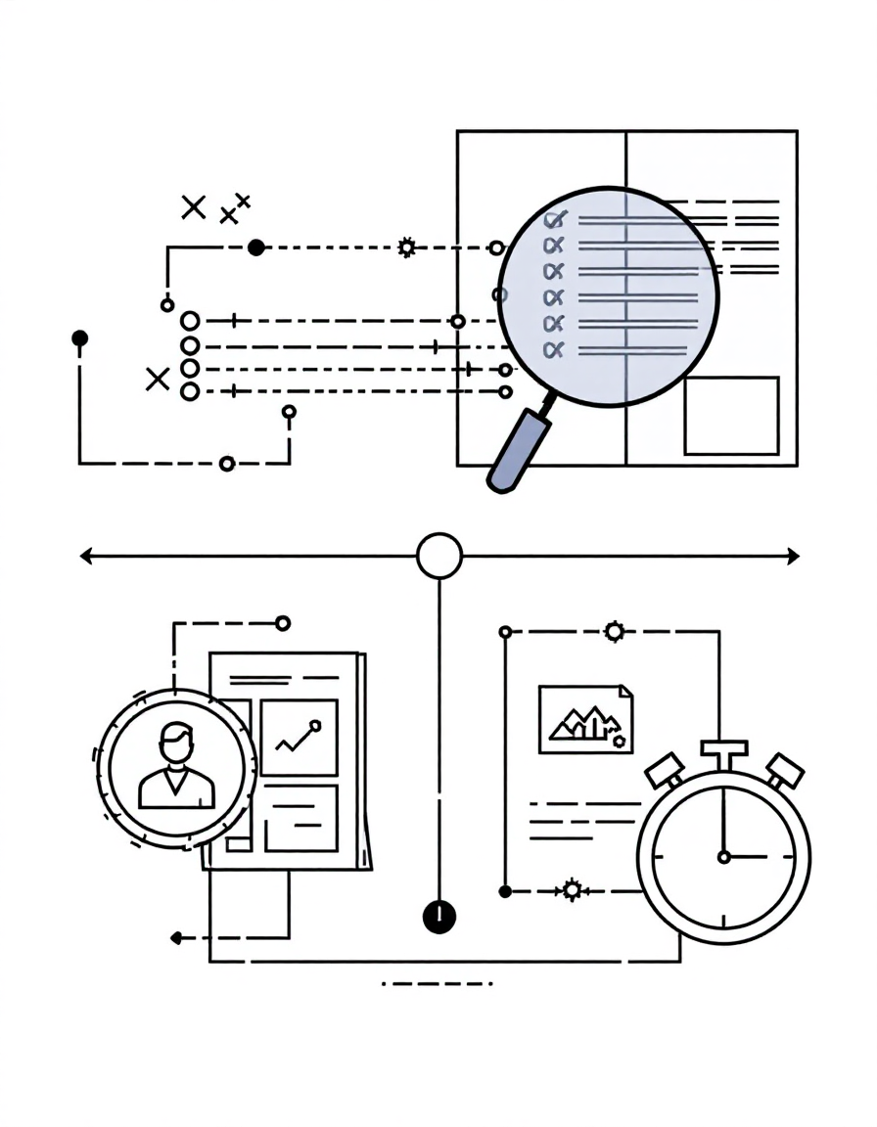
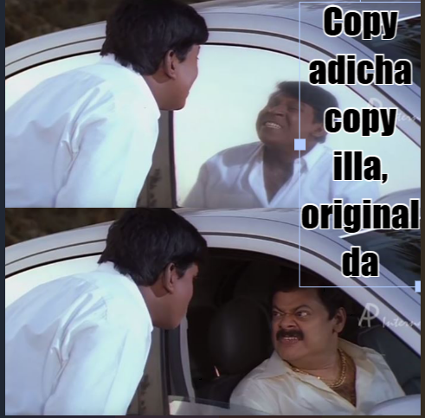
SLSA Level 3 — “Build is Hermetic & Reproducible”
Builds are fully automated and reproducible.
Same inputs = same outputs. 🧠 Punchline: No “more ‘works on my machine’ drama!”

Slide 12
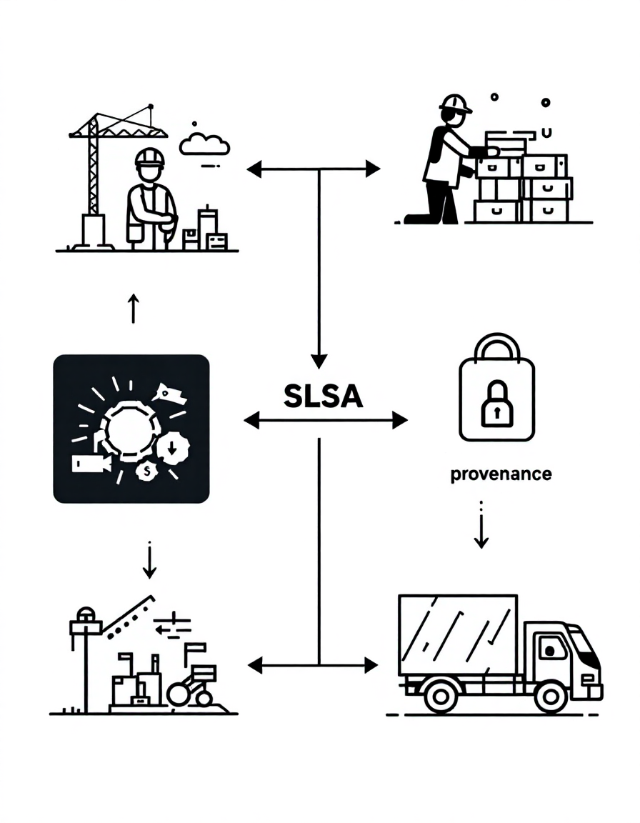
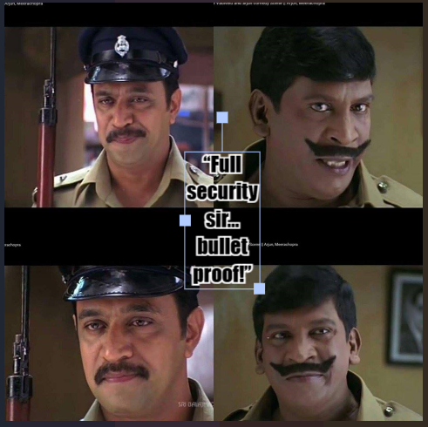
SLSA Level 4 — “Complete End-to-End Security”
Two-person review before submission.
Provenance is generated automatically by a secure,
isolated build system. 🧠 Punchline “even the hacker will say ‘Respect bro!’”

Slide 13
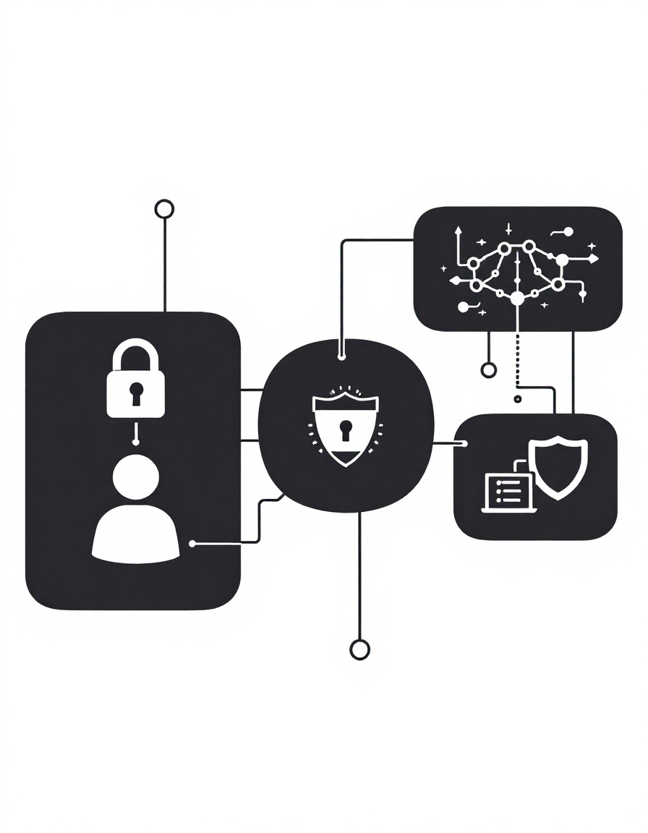
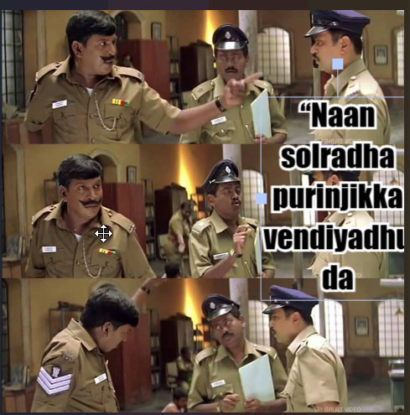
Why OWASP folks should care
SLSA complements OWASP’s Software Component Verification.
Helps prevent dependency attacks,
Ttampering, and build compromise.

Slide 14
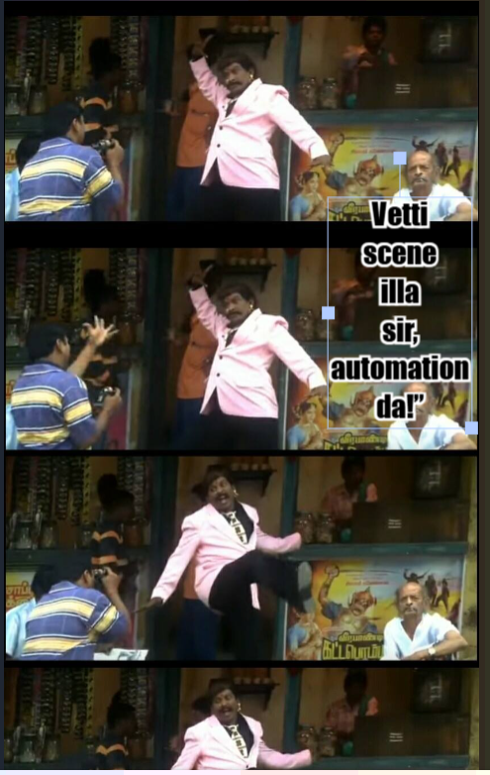
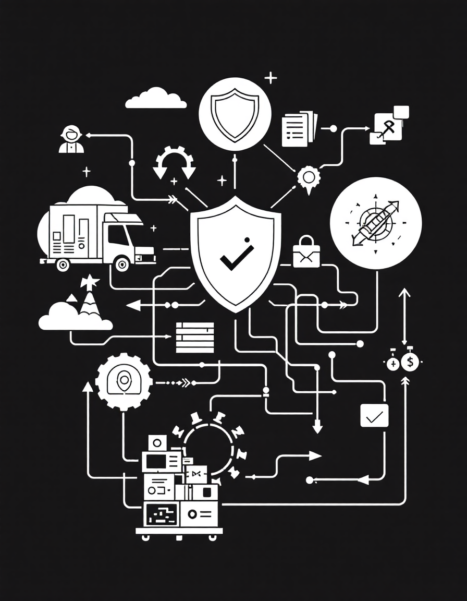
Demo

